Slide 1
Unit IV
DATA VISUALIZATION

Slide 2
Data Visualization
Data Visualization is the graphical representation of information and data. It uses visual elements like charts, graphs, and plots to make complex data easier to understand, interpret, and communicate.
Importance:
Simplifies complex data.
Helps in identifying patterns and correlations.
Facilitates better decision-making.
Communicates data insights clearly to others.

Slide 3
Installing and Importing Libraries
Before starting with visualization, install the necessary libraries using pip:
pip install matplotlib seaborn numpy
Then, import them in Python:
import matplotlib.pyplot as plt
import seaborn as sns
import numpy as np

Slide 4
Line plots
A line plot is a type of chart that displays data points connected by straight lines.
It is used to visualize trends, patterns, or relationships between two continuous variables, often over time or sequence.

Slide 5
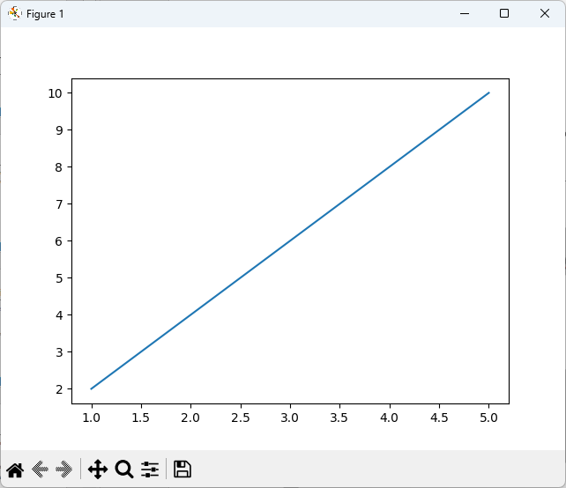
Creating Line Plots with Matplotlib
import matplotlib.pyplot as plt
import numpy as np
x = np.array([1, 2, 3, 4, 5])
y = np.array([2, 4, 6, 8, 10])
plt.plot(x, y) # creates a line plot
plt.show()

Slide 6
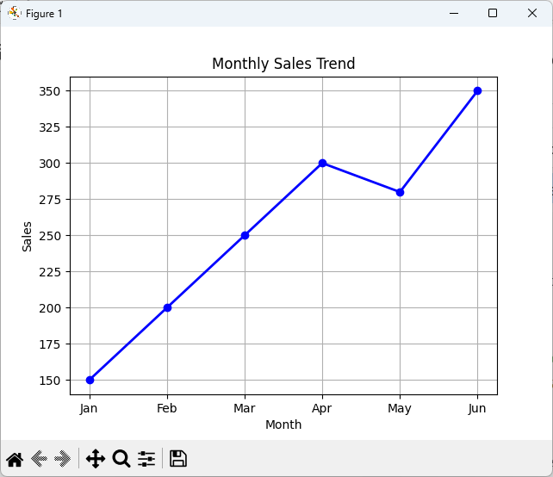
Example : Simple Line Plot
import matplotlib.pyplot as plt
months = ['Jan', 'Feb', 'Mar', 'Apr', 'May', 'Jun']
sales = [150, 200, 250, 300, 280, 350]
# Plot
plt.plot(months, sales, color='blue', marker='o', linestyle='-', linewidth=2)
# Add title and labels
plt.title("Monthly Sales Trend")
plt.xlabel("Month")
plt.ylabel("Sales")
plt.grid(True)
plt.show()

Slide 7
Scatter plots
A scatter plot is a type of chart that displays individual data points on a two-dimensional graph. It is used to visualize the relationship or correlation between two variables. Each point represents a single observation.
Key uses:
Identify trends or patterns between variables.
Detect clusters or groups in data.
Spot outliers or unusual points.

Slide 8
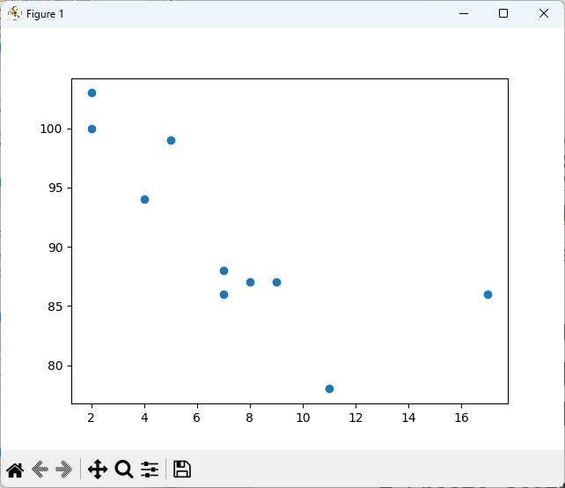
Creating Scatter Plots with Matplotlib
import matplotlib.pyplot as plt
import numpy as np
# Generate data
x = np.array([5, 7, 8, 7, 2, 17, 2, 9, 4, 11])
y = np.array([99, 86, 87, 88, 100, 86, 103, 87, 94, 78])
# Create scatter plot
plt.scatter(x, y)
plt.show()

Slide 9
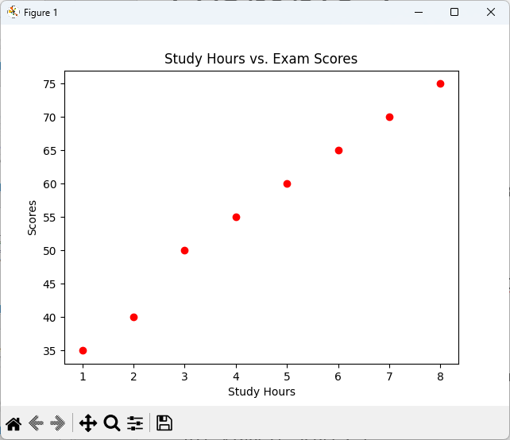
Example 1
import matplotlib.pyplot as plt
# Data: Study Hours vs. Scores
study_hours = [1, 2, 3, 4, 5, 6, 7, 8]
scores = [35, 40, 50, 55, 60, 65, 70, 75]
# Scatter plot
plt.scatter(study_hours, scores, color='red', marker='o')
# Add title and labels
plt.title("Study Hours vs. Exam Scores")
plt.xlabel("Study Hours")
plt.ylabel("Scores")
plt.show()

Slide 10
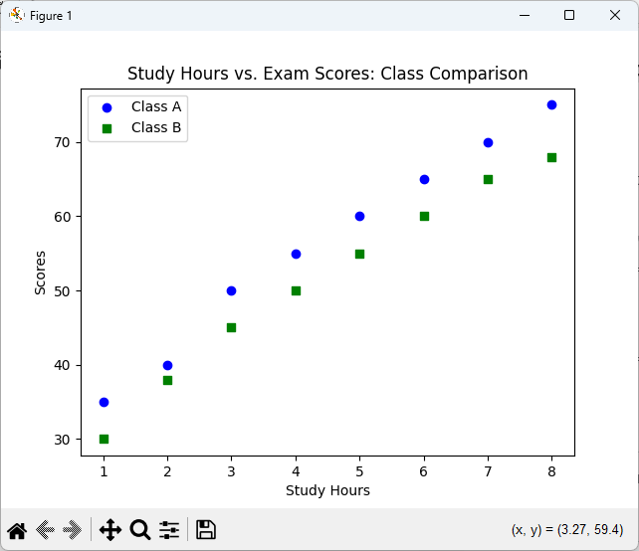
Example 2: Scatter Plot with Multiple Groups
import matplotlib.pyplot as plt
study_hours_class_a = [1, 2, 3, 4, 5, 6, 7, 8]
scores_class_a = [35, 40, 50, 55, 60, 65, 70, 75]
study_hours_class_b = [1, 2, 3, 4, 5, 6, 7, 8]
scores_class_b = [30, 38, 45, 50, 55, 60, 65, 68]
# Scatter plot for Class A
plt.scatter(study_hours_class_a, scores_class_a, color='blue', marker='o', label='Class A')
# Scatter plot for Class B
plt.scatter(study_hours_class_b, scores_class_b, color='green', marker='s', label='Class B')
# Add title, labels, and legend
plt.title("Study Hours vs. Exam Scores: Class Comparison")
plt.xlabel("Study Hours")
plt.ylabel("Scores")
plt.legend()
plt.show()

Slide 11
Visualizing errors
Error bars are graphical representations of variability or uncertainty in data. They show how much a measurement might deviate from the actual value.
Helps indicate precision of measurements or predictions.
Makes it easy to compare data reliability across points.
Can be used in line plots, scatter plots, or bar charts.

Slide 12
Creating Error Bars with Matplotlib
import matplotlib.pyplot as plt
import numpy as np
# Data: Students' test scores with measurement errors
students = np.array([1, 2, 3, 4, 5, 6, 7])
scores = np.array([75, 80, 78, 85, 90, 88, 82])
score_error = np.array([2, 3, 2, 4, 3, 2, 3]) # Possible error in scores
# Scatter plot with error bars
plt.errorbar(students, scores, yerr=score_error, fmt='o', ecolor='red', capsize=5)
# Add title and labels
plt.title("Student Scores with Error Bars")
plt.xlabel("Student Number")
plt.ylabel("Score")
plt.grid(True)
plt.show()

Slide 13
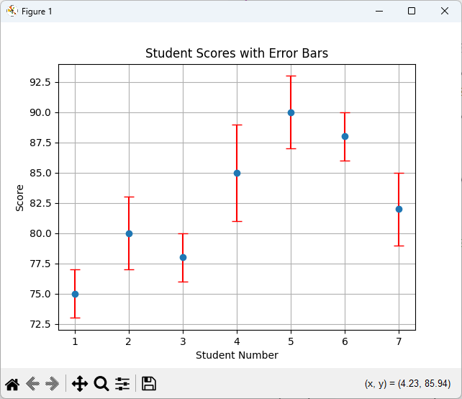
Creating Error Bars with Matplotlib

Slide 14
Density and contour plots
Density plots are visualizations that show the distribution of points in a dataset, usually in two dimensions.
Contour plots are similar but display lines (contours) connecting points of equal value, like a topographic map.
Key uses:
Understand 2D distributions.
Visualize peaks, valleys, or clusters in data.
Useful in geography, physics, and data science for representing surfaces.

Slide 15
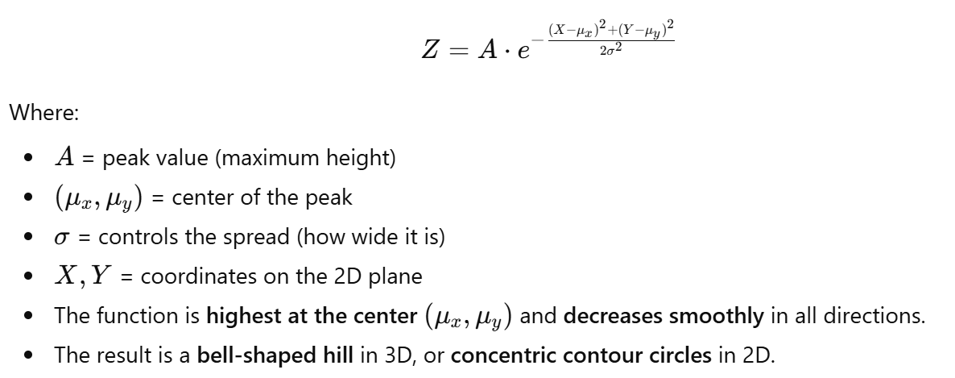
What is a 2D Gaussian Function?
A 2D Gaussian function is an extension of the 1D Gaussian (bell curve) into two dimensions.
Mathematical form:

Slide 16
1. Contour/Density plots require a grid
Suppose you want to plot:
Z=X²+Y²
You don’t just need x-values or y-values separately. You need all combinations of x and y to know what Z is at each point.
For example:
x = [-1, 0, 1] y = [-1, 0, 1]
x | y | Z = x² + y²
-1 | -1 | 2
0 | -1 | 1
1 | -1 | 2
-1 | 0 | 1
0 | 0 | 0
1 | 0 | 1
-1 | 1 | 2
0 | 1 | 1
1 | 1 | 2

Slide 17
Plot Type | Data Source | Need for linspace
Line Plot | Discrete measurements | Usually NO
Scatter Plot | Discrete measurements | Usually NO
Contour/Density | Function over 2D grid | YES, for smooth visualization
In contour plots,
Z = function value.
In 2D density plots,
Z = density of points at each (X, Y) position.

Slide 18
Contour plot
For a contour plot, we are plotting a function of two variables, e.g.,
Z = f(X,Y)
Z is not a set of discrete measurements, but a mathematical function defined everywhere in a region.
To visualize it, we need a grid of points covering the x-y plane.
np.linspace() creates evenly spaced points along x and y axes, and meshgrid() generates all combinations so we can compute Z at each point.

Slide 19
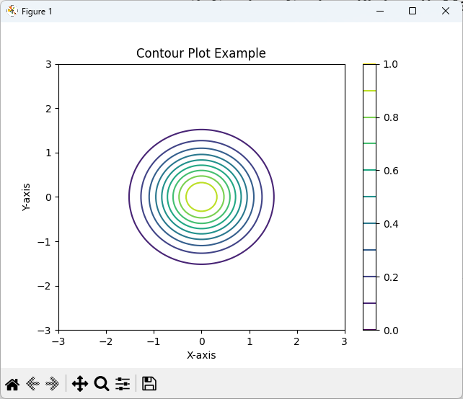
Creating Contour Plots with Matplotlib
import matplotlib.pyplot as plt
import numpy as np
# Generate grid data
x = np.linspace(-3, 3, 100)
y = np.linspace(-3, 3, 100)
X, Y = np.meshgrid(x, y)
# Function to visualize
Z = np.exp(-(X**2 + Y**2)) # 2D Gaussian
# Contour plot
plt.contour(X, Y, Z, levels=10, cmap='viridis')
plt.title("Contour Plot Example")
plt.colorbar() # Show color scale
plt.xlabel("X-axis")
plt.ylabel("Y-axis")
plt.show()

Slide 20
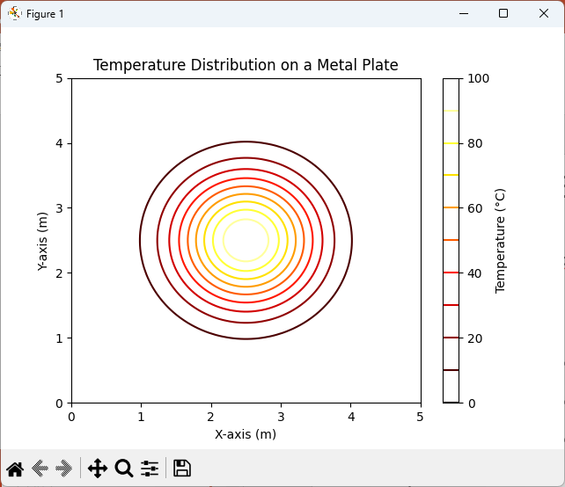
Example 2: Temperature Distribution
import numpy as np
import matplotlib.pyplot as plt
# Create grid
x = np.linspace(0, 5, 100) # X-axis: 0 to 5 units
y = np.linspace(0, 5, 100) # Y-axis: 0 to 5 units
X, Y = np.meshgrid(x, y)
# Define temperature function
Z = 100 * np.exp(-((X-2.5)**2 + (Y-2.5)**2))
# Contour plot
plt.contour(X, Y, Z, levels=10, cmap='hot')
plt.colorbar(label="Temperature (°C)")
plt.title("Temperature Distribution on a Metal Plate")
plt.xlabel("X-axis (m)")
plt.ylabel("Y-axis (m)")
plt.show()

Slide 21
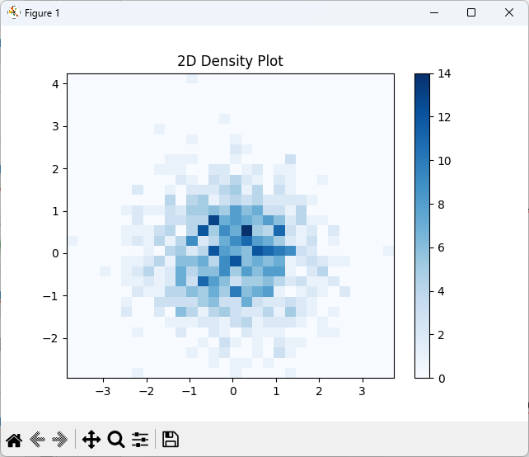
2D Density Plot - Example
Code:
import numpy as np
import matplotlib.pyplot as plt
x = np.random.randn(1000)
y = np.random.randn(1000)
plt.hist2d(x, y, bins=30, cmap='plasma')
plt.colorbar()
plt.title('2D Density Plot')
plt.show()

Slide 22
Plot Type | Real-Life Example | Data Type | What It Shows
Contour Plot | Temperature on a metal plate | Continuous field (function) | Smooth function; lines of equal value
2D Density Plot | Bird locations in a park | Many discrete points (KDE) | Where points cluster; “hotspots”

Slide 23
Histograms
Histograms display the distribution of a dataset by dividing it into bins and counting the number of values in each bin. They are useful for analyzing data spread, skewness, and frequency.

Slide 24
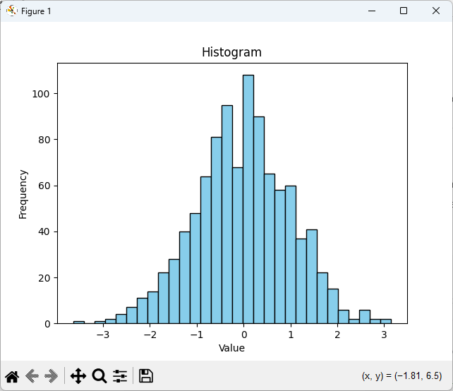
Example
import matplotlib.pyplot as plt
import numpy as np
data = np.random.randn(1000)
plt.hist(data, bins=30, color='skyblue', edgecolor='black')
plt.title('Histogram')
plt.xlabel('Value')
plt.ylabel('Frequency')
plt.show()

Slide 25
Visualization with Seaborn
Seaborn is a Python library for statistical data visualization, built on Matplotlib. It provides aesthetically pleasing and high-level plotting functions for exploratory data analysis.
Key Features:
Automatic color palettes and styles.
Works seamlessly with Pandas DataFrames.
Supports advanced plots: histograms, KDE plots, scatter with regression, box plots, and heatmaps.

Slide 26
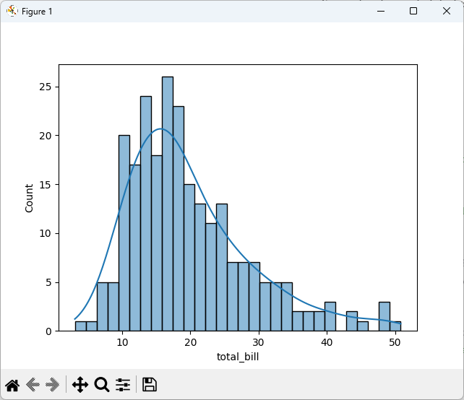
Example
import seaborn as sns
import matplotlib.pyplot as plt
# Load sample dataset
tips = sns.load_dataset('tips')
# Histogram with density
sns.histplot(tips['total_bill'], bins=30, kde=True)
plt.show()
# Scatter plot with regression
sns.lmplot(x='total_bill', y='tip', data=tips)
plt.show()
# Box plot (categorical comparison)
sns.boxplot(x='day', y='total_bill', data=tips)
plt.show()

Slide 27
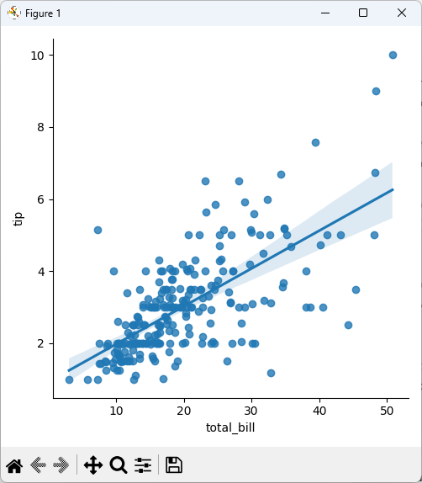
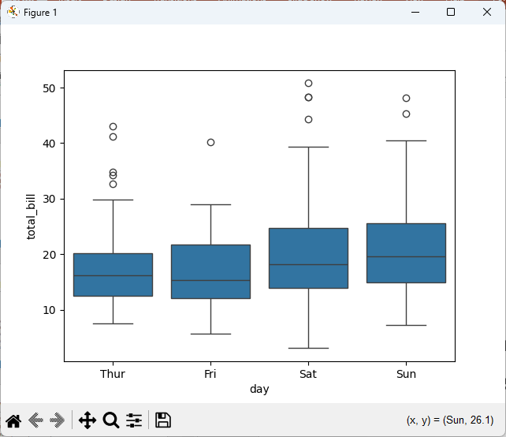
Notes:
Kde = True adds a smooth density curve.
Seaborn simplifies statistical visualization with minimal code.

